Slide 1

BUSINESS ORGANISATIONS
NAME :- Ch. Mohan Reddy
REG NO:- 192110740
DEPT :- CSE

Slide 2
ABSTRACT:-
A business entity is an organization that needs fund, labour, machines or inputs to provide goods or services to the customers with the transactions through the medium of money or in monetary terms. But such an organization can take many forms.

Slide 3
INTRODUCTION :-
Business organization refers to the act of bringing resources and utilizing them in the best possible manner for the production and distribution of goods and services in order to earn profit through the service and satisfaction of the customers.

Slide 4
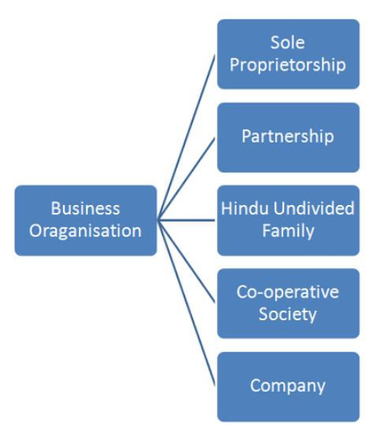
Types of business organisations:-

Slide 5
SOLE PROPRIETORSHIP:-
The simplest and most common form of business ownership, sole proprietorship is a business owned and run by someone for their own benefit.
The sole proprietorship of a company suggests that the complete ownership of that organization lies with a single person.

Slide 6
ADVANTAGES OF SOLE PROPRIETORSHIP:-
you're the boss.
you keep all the profits.
start-up costs are low.
you have maximum privacy.
establishing and operating your business is simple.

Slide 7
DISADVANTAGES OF SOLE PROPRIETORSHIP:-
you have unlimited liability for debts as there's no legal distinction between private and business assets.
your capacity to raise capital is limited.
all the responsibility for making day-to-day business decisions is yours.
retaining high-calibre employees can be difficult.

Slide 8
PARTNERSHIP:-
A partnership business, by definition, consists of two or more people who combine their resources to form a business and agree to share risks, profits and losses. Common partnership business examples include law firms, physician groups, real estate investment firms and accounting groups.

Slide 9
ADVANTAGES OF PARTNERSHIP:-
Two heads (or more) are better than one.
Your business is easy to establish and start-up costs are low.
More capital is available for the business.
You'll have greater borrowing capacity.
High-calibre employees can be made partners.

Slide 10
DISADVANTAGES OF PARTNERSHIP:-
Liabilities.
Loss of Autonomy.
Emotional Conflict.
Future Selling Complications.
Lack of Stability.

Slide 11
HINDHU UNDIVIDED FAMILY:-
It refers to a form of business organization which is owned and carried on jointly by the members of the Hindu Undivided Family (HUF). It is also known as Hindu Undivided Family Business.

Slide 12
ADVANTAGES OF “HUF”:-
However, under HUF, one can enjoy additional tax benefits on the rent of the land. For a HUF member, the taxes would be reduced to an amount of Rs. 60,000 to 70,000. That means you will be able to save tax around Rs 1,80,000- Rs 60,000=Rs.

Slide 13
DISADVANTAGES OF “HUF”:-
One of the primary disadvantages of building a HUF is that every member of the family has the same rights on every asset of the family.
The common property cannot be sold without getting the consent of everyone in the family. Besides that, birth and marriages increase the number of family members.

Slide 14
CO-OPERATIVE SOCIETY:-
Cooperative societies are formed with the aim of helping their members. This type of business organisation is formed mainly by weaker sections of the society in order to prevent any type of exploitation from the economically stronger sections of the society.

Slide 15
ADVANTAGES OF CO-OPERATIVE SOCIETY:-
Bonding, Support, and Playfulness.
Openness, Trust and Safety.
Self Worth and Personal Power.
Well-being.

Slide 16
DISADVANTAGES OF CO-OPERATIVE SOCIETY:-
Members have equal voting rights regardless of investment
Less Operational Control.
Fixed Pricing.

Slide 17
COMPANY:-
A company is a type of business structure that is a separate legal entity from its owners. It's a complex business structure, with higher set-up and administrative costs because of extra reporting requirements and higher-level legal obligations.

Slide 18
ADVANTAGES OF COMPANY:-
liability for shareholders is limited.
it's easy to transfer ownership by selling shares to another party.
shareholders (often family members) can be employed by the company.
taxation rates can be more favourable.

Slide 19
DISADVANTAGES OF COMPANY:-
The company can be expensive to establish, maintain and wind up.
The reporting requirements can be complex.
Your financial affairs are public.
Profits distributed to shareholders are taxable.

Slide 20
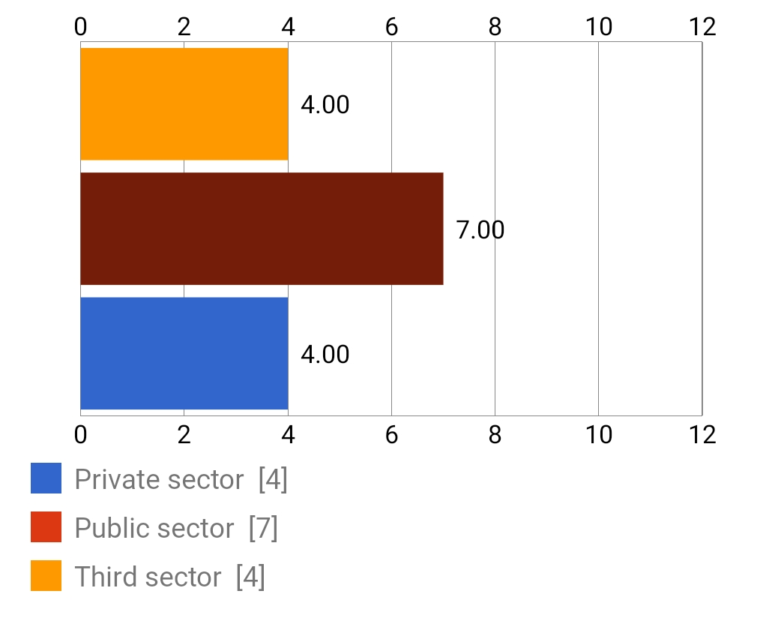
Google survey:-

Slide 21
CONCLUSION :-
Organizations can function within a number of different structures, each possessing distinct advantages and disadvantages. Although any structure that is not properly managed will be plagued with issues, some organizational models are better equipped for particular environments and tasks.

Slide 22
REFERENCE:-
https://biz.libretexts.org/Courses/Kwantlen_Polytechnic_University/BUSI1215_Organizational_Behaviour/12%3A_Managing_Change/12.6%3A_Conclusion

